Slide 1
ZAM – SERVIS
PRODUCTS FOR SHAFTS IN
ENVIRONMENT WITH EXPLOSIVE HAZARD
Notes:
1

Slide 2
ZAM – SERVIS, s.r.o.
We are a private independent company. We deal with the service, production and supply of electrical, electronic, safety, measuring, adjusting and analysing devices. You can find us in Ostrava Přívoz, where you can look at the major part of our products as well as try them. We have commercial representations in Poland and in the Slovak Republic as well as a wide range of local vendors.
Notes:
2

Slide 3
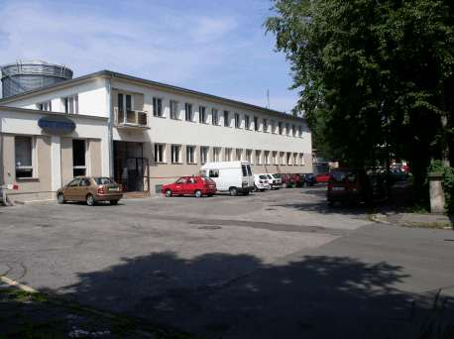
ZAM –SERVIS,s.r.o.,
Křišťanova 1116/14, Ostrava – Přívoz, Czech Republic
Notes:
3

Slide 4
Organization Structure
The company structure is subordinate to our main activities, this means that the maximal number of employees work in the production and service sections. We find consultancy and engineering to be substantial activities. They are provided by the business department in collaboration with the workers of development. A vast range of activities, e.g. projecting, engineering and mechanical productions or road transport are provided by suppliers. We lay stress on the continuous innovation of products and on the development of new ones.
How to Go On
Today, more than ever before, the matter of quality is gaining ground. It requires not only perfect products, but also quite a number of further items. If a potential costumer gets in touch with us, he or she can rely on the fact that we will fully devote our time to him/her , that we will give him professional advice on device choice and that we will provide him/her with the device in the agreed time and under the agreed terms. We managed to satisfy the conditions for implementation of the ISO 9001:2000 standard, thus we can guarantee the above-mentioned goals. We have had the certificate since 1999.
Notes:
4

Slide 5
Products for an environment with an explosion hazard
This is a presentation of devices intended for assembly and operation in an environment with an explosion hazard of gases and dust, mainly in underground mines. The main attributes of these products are the ability to operate safely and reliably in an environment with an explosion hazard of methane. All products are certified by the State Testing Laboratory 210 in Ostrava Radvanice and by the Czech Mining Office Board.
The producer is prepared to modify the existing devices according to customer's requirements.
Notes:
5

Slide 6
Products for an environment with an explosion hazard
Level Measurement
High-Frequency Signalling from the Cage
Voice Communicating System
Helmet Communicating System
Mine Mercaptan Signalling
Signalling, Switching and Interconnecting Devices
Automation, Measuring and Control Members
Rescue Speech System
Telephone Connection System
Distributed Telecommunication and Safety System
Camera System
Notes:
6

Slide 7
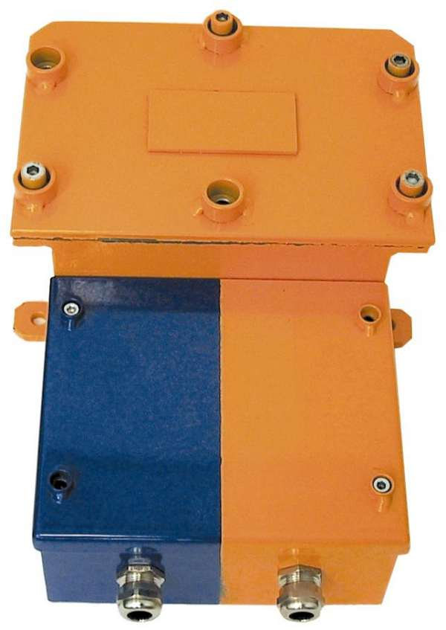
JBP-BOS – Converter D/A with JB Inlets
Notes:
7

Slide 8
JBP-BOS – D/A Converter with JB Inlets
The spark-safe converter tzp JBP-BOS is intended for the separation of JB circuits from power circuits in an environment of the methane explosive hazard of SNM 2.
For example, it can be used for the control of the level heights of liquids and loose materials or, generally, for transmitting of information on resistance change in the JB circuit on the inlet into the device.
Notes:
8

Slide 9
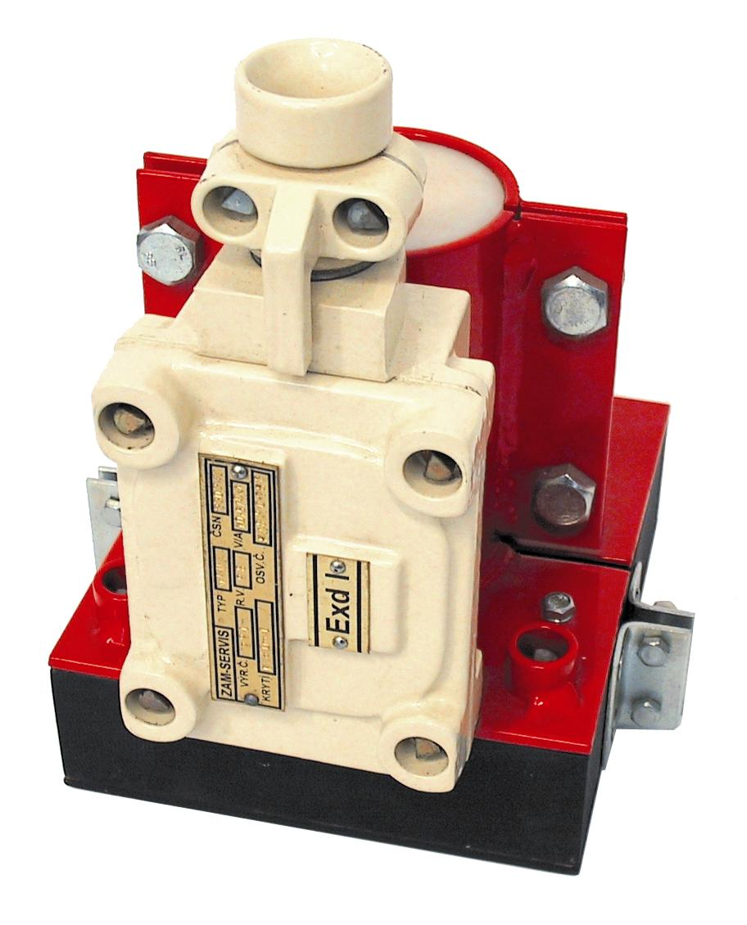
VFSK 41 – High-Frequency Signalling from from the Kibble for Two Winding Shafts
Transmitting Aerial VAM (VAV)
Notes:
9

Slide 10
VFSK 41 – High-Frequency Signalling from the Kibble for Two Winding Shafts
The VFSK-41 device is intended for a wireless signal between two ropeway buckets and the operation staff of a winding machine. The main usage consists in pits of underground mines for winding machines with a low balancing rope or without it.
The VFSK-41 device may be used in an environment with a hazard of methane explosion (SNM 2).
Notes:
10

Slide 11
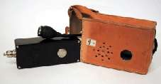
HKZ-1 – Voice Communication System in a Winding Cage
Radio Station DUP 01
Notes:
11

Slide 12
HKZ-1 – Voice Communication System in a Winding Cage
The HKZ-1 connecting link is a communication device intended for mines. The device enables wireless communication of the engine room operation staff with workers in the winding cage. The voice communication completes the HF signalling device VFSK-41 in the cage.
Notes:
12

Slide 13
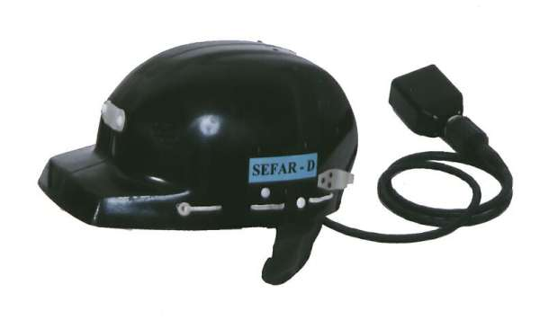
SEFAR AB1 – Helmet Communication System
Notes:
13

Slide 14
SEFAR AB1 – Helmet Communication System
The mine communication and safety system is intended for providing of voice connection and safety in mining, in belt roadways but also in all the other rooms of mining plants. It provides half-duplex one-channel voice communication between radio stations placed in mining helmets and it is intended to block a mining machine by means of a switch from the mining helmet. It is intended for an environment with the methane explosive hazard of SNM2.
Notes:
14

Slide 15
DMS-32 – Mining Mercaptan Signalling, Evacuation System
Mining mercaptan signalling of DMS 32 warns mining workers against the danger that has emerged from an emergency situation in the coal mine by means of an inert aromatic agent let out to a wind stream and it secures their fast withdrawal from the room in danger. The mining parts are divided according to user's needs. Their control is secured by the surface part located in the dispatching site. The signalling is designed as the sectional one.
The device is intended for an environment with the explosive hazard of SNM2.
Notes:
15

Slide 16
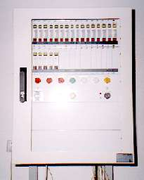
DMS-32 – Mine Mercaptan Signalling, Evacuation System
Mine Part DMS-PD
Notes:
16

Slide 17
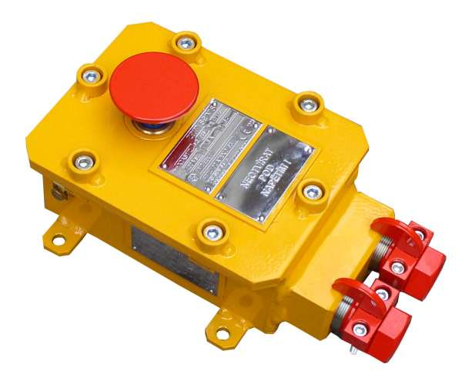
Signalling, Switching and Interconnecting Devices
X2AST/Z – emergency stop button
Notes:
17

Slide 18
X2AST/Z – Emergency Stop Button
An inexplosive emergency stop button with an arrestment is used for emergency switch-off and blocking of operation of industrial machines with an electric control. Having been pushed, the button remains in a switch-off position and it is necessary to draw it back to the initial position in order to renew the working function of the machine or drive.
Notes:
18

Slide 19
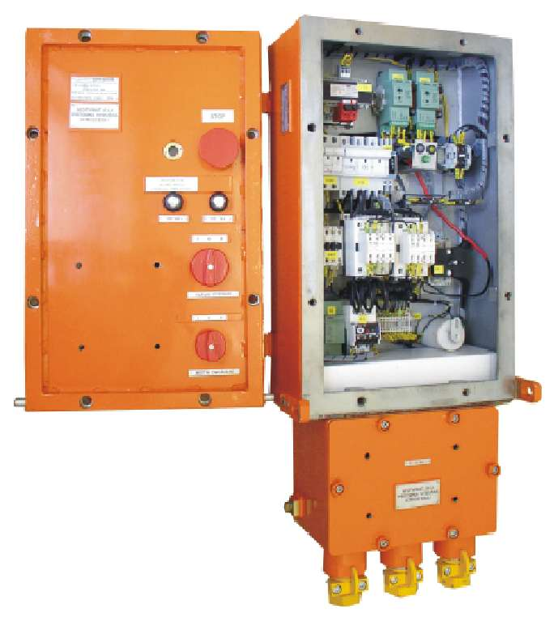
NRS – Inexplosive Contactor Set
Notes:
19

Slide 20
NRS – Inexplosive Contactor Set
Inexplosive contactors are intended for usage in mine workings with an environment with the methane explosion hazard or for internal use in rooms different than the mining ones with the methane and dust explosive hazards. Inexplosive contactors are intended for remote controlling of electrical appliances, e.g. drives. The inexplosive contactors are designed with the flameproof enclosure of EExdI. The boxes are made of steel welding and equipped with a protective surface (galvanizing and powder paint Komaxit).
The contactor consists of two independent rooms interconnected with inexplosive bushings.
The box of the inexplosive contactor consists of two parts, the instrument one and the terminal board one.
Notes:
20

Slide 21
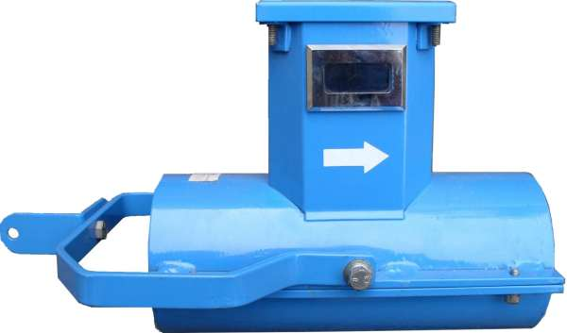
As–3c – Stationary Anemometer, a Wind-Flow Gauge
Notes:
21

Slide 22
As–3c – Stationary Anemometer, a Wind-Gauge
A stationary anemometer, type: As-3c, is intended for measuring of air flow speed in entries, tunnels, collectors etc. in an environment with the increased hazard of methane explosion (SNM 3).
Notes:
22

Slide 23
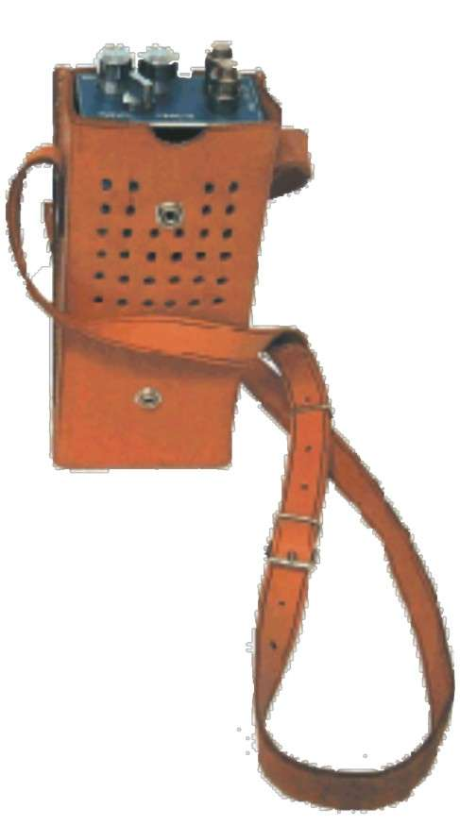
AZJ – Rescuer Speech System
Notes:
23

Slide 24
AZJ – Rescuer Speech System
The device is intended for a loud communication between a rescuer and the operator console. It is suitable in the places where it is necessary to establish voice connection, e.g. in rescue operations in mines etc.
The device may be used in the rooms with a high hazard of methane explosion (SNM3) because it is in the spark-safe design of ExiaI.
Notes:
24

Slide 25
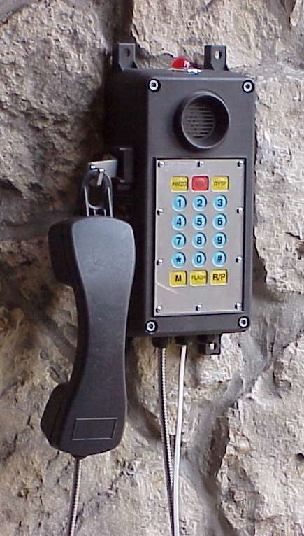
TSP – Telephone Connection System for Industrial Plants
Notes:
25

Slide 26
TSP, ZITG-02, PST – Telephone Connection System for Industrial Plants
The device for a telephone connection in heavy industrial plants like TSP, PST and ZITG is intended for an environment with high air moisture, or with drip water and abundance in dust (coal-dust or rock dust) in the design with the IP65 protection and, further, it is intended for an environment with the hazard of methane explosion in the design of 1 MI EEx ia I for underground mines and for the environments with an explosive hazard in chemical plants in the design of EEx ia II.
Notes:
26

Slide 27
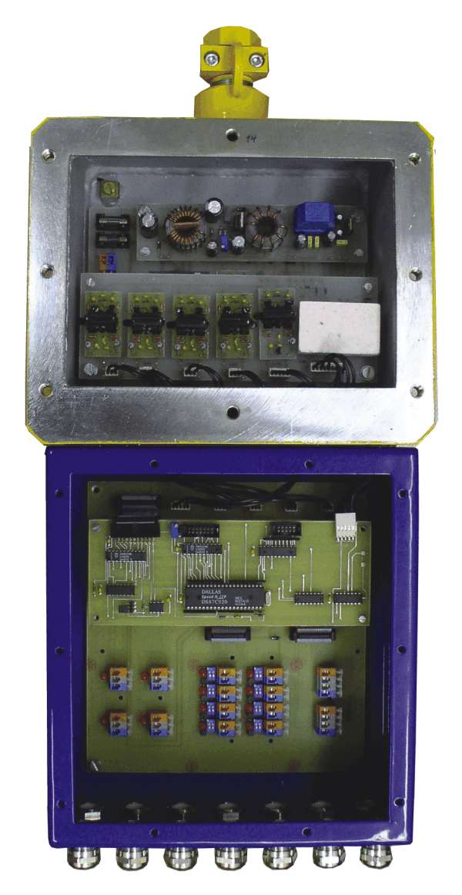
DPS – 2000 – Mine transmission SCADA System
Notes:
27

Slide 28
DPS – 2000 – Mine transmission SCADA System
A mine transmission SCADA System are modular systems for a two-way information transmission between the mining part consisting of the DKD 2000 data concentrators with terminal sensors and the surface part formed by the communication and feeding units of PKD 2000 connected to the SGS32 - tess intelligent concentrator and, subsequently, through the SGS32-server safety server to the dispatching information network on the level of SGS32-client and, further, to the global information network of the mining plant. It follows the current needs of mine plants to transmit a great amount of technological and safety information from the mine to the surface dispatching site.
Notes:
28

Slide 29
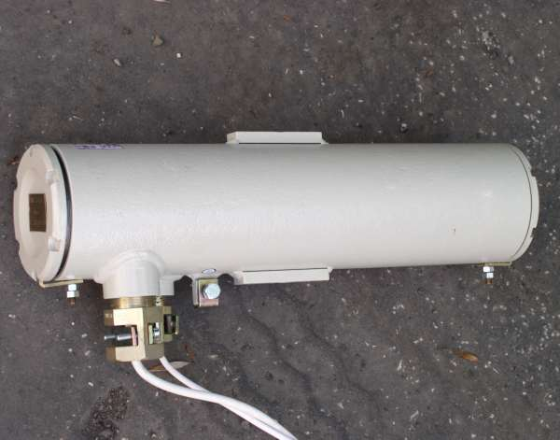
KOR-2 – Inexplosive Camera
Notes:
29

Slide 30
KOR-2 –Inexplosive Camera
The KOR-2.1 industrial camera is intended for a remote monitoring of devices and the course of technological processes in underground mines in the areas where there is no permanent operation staff and in the places with the increased hazard of methane explosion (SNM 2) and shock bumps. It is also intended for the environment of ZONA 1 and 2 with the hazard of the explosion of explosive gas mixture and vapours, ZONA 10 and 11 with the hazard of combustible dust, fibre and metal powder explosion.
The design of the camera is EExd I/II CT6.
The camera may be connected to a monitor placed in the environment without an explosive hazard or it has to be in the design of EEx I/II CT6.
Notes:
30

Slide 31
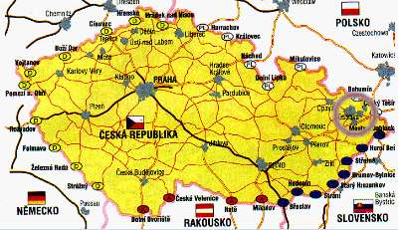
WWW.ZAM.CZ
ZAM - SERVIS s.r.o.
Domicile: Křišťanova 1116/14
702 00 Ostrava-Přívoz, Czech Republic
Tel.: +420 59 613 54 22
Fax: +420 59 613 54 25
e-mail: zam@zam.cz
Notes:
31

